Slide 1


VEXed by vulnerabilities that don’t affect your product? Try this one easy trick!
Allan Friedman, PhD Senior Advisor and Strategist Cybersecurity and Infrastructure Security Agency
allan.friedman@cisa.dhs.gov
Vulnerability Exploitability eXchange

Slide 2
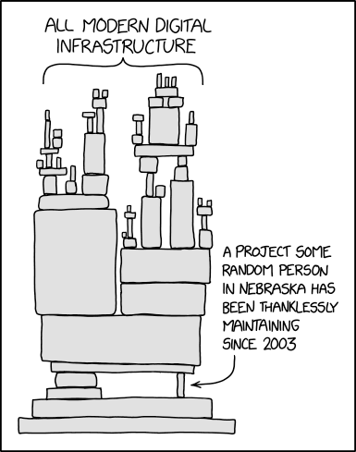
Paying attention vs cleaning inbox?
Motivations: vulnerabilities and SBOM
What do we actually care about?
VEX overview
Security advisories… but automated
VEX implementation and evolution
Challenges for automation
https://xkcd.com/2347/

Slide 3

Still cooking this up
Notes:
Julia Child in her kitchen as photographed ©Lynn Gilbert, 1978

Slide 4

But there’s plenty to sample today
Notes:
Julia Child in her kitchen as photographed ©Lynn Gilbert, 1978

Slide 5







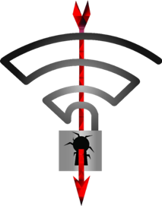


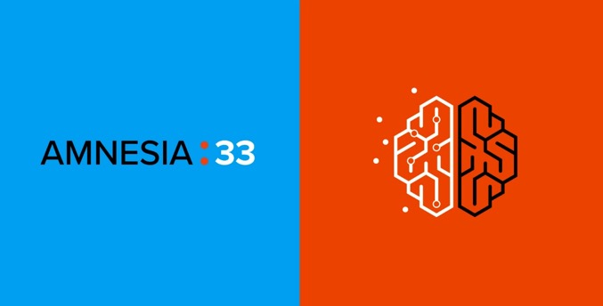
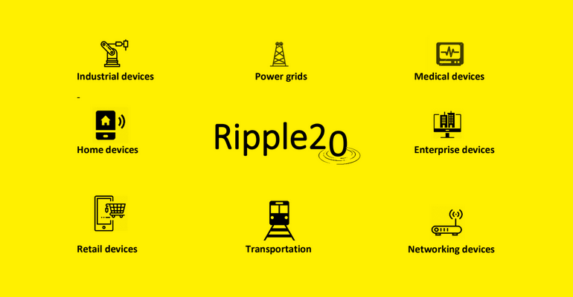

Known vulnerabilities Should be the easiest part

Slide 6
How to communicate vulnerabilities?
CVE
Notes:
Allan -
Limits of CVE
(or other vulnerability DBs)

Slide 7
How to communicate affected versions and remediations for vulnerabilities?
Security Advisories
Notes:
Jens

Slide 8

We will know about more potential vulnerabilities with SBOM
https://boyter.org/static/books/new2.jpg
Notes:
And be

Slide 9
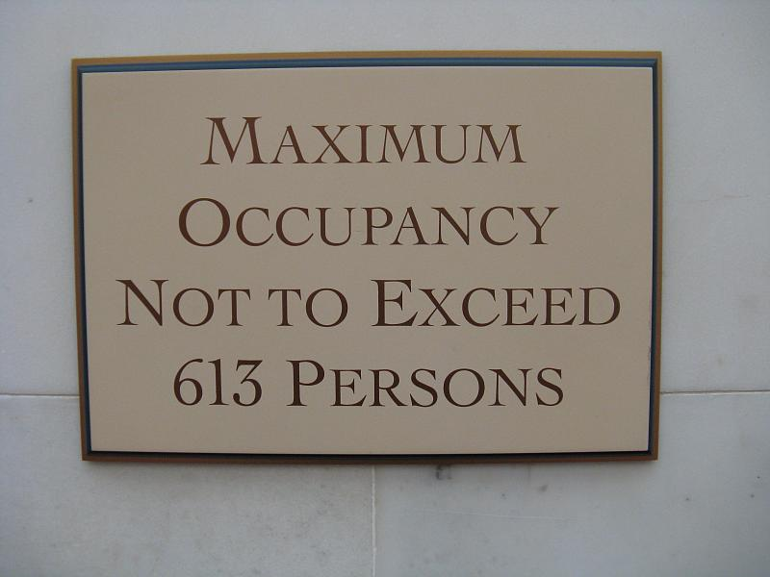
Vulnerabilities
https://www.flickr.com/photos/sadsnaps/2983577932

Slide 10

Not all vulnerabilities are exploitable
BUT: Not all vulnerabilities are actually exploitable
Notes:
Allan
Openssl 1.0.1
Cite some Veracode estimates
“estimates vary – some security vendors put it below 10% (although there’s a vested interest)”

Slide 11
We need a way to communicate that your product is not affected

Slide 12
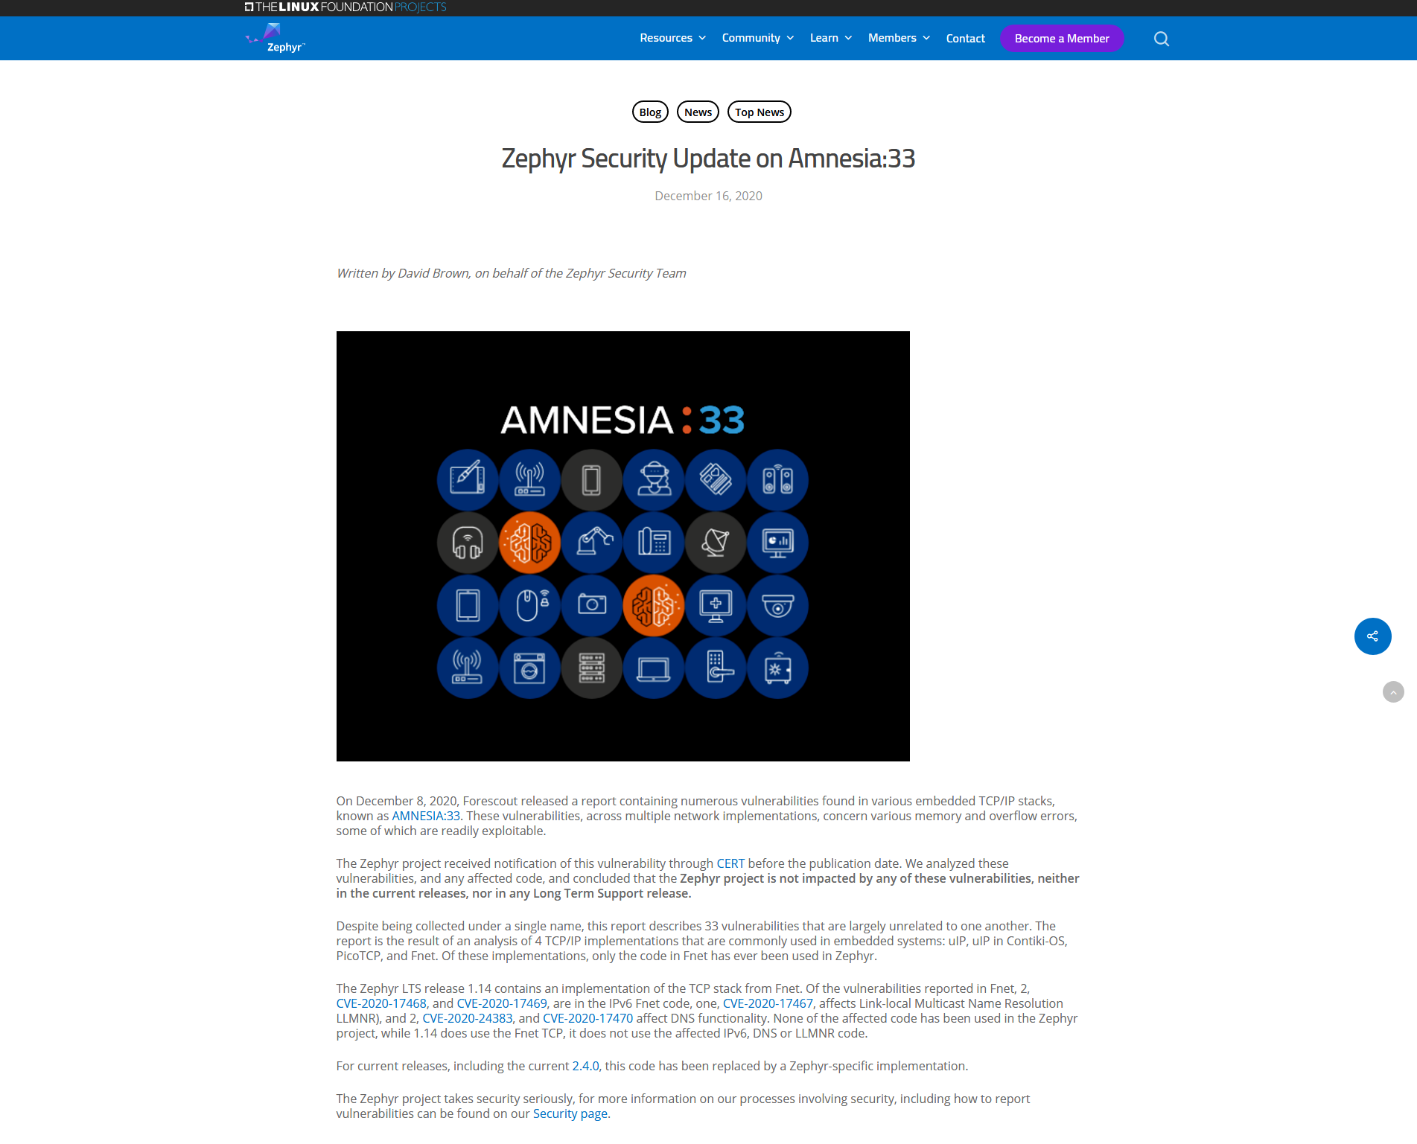
https://www.zephyrproject.org/zephyr-security-update-on-amnesia33/

Slide 13
https://www.zephyrproject.org/zephyr-security-update-on-amnesia33/

Slide 14

Scaling

Slide 15
How many device types (Zephyr or other) are in your facility?
Does that method scale?
Notes:
Not imaginary - Real world scaling

Slide 16
How to communicate that a product is (not) “exploitable”?
Vulnerability Exploitability eXchange (VEX)

Slide 17
“exploitable”

Slide 18
“affected”
Do I need to do anything?
Notes:
Actions are recommended to remediate or address this vulnerability.
This could include for instance learning more about the vulnerability and context, and/or making a risk-based decision to patch or apply defense-in-depth measures

Slide 19
“affected”
Actions are recommended to remediate or address this vulnerability.
This could include: learning more about the vulnerability and context, and/or making a risk-based decision to patch or apply defense-in-depth measures
Notes:
Actions are recommended to remediate or address this vulnerability.
This could include for instance learning more about the vulnerability and context, and/or making a risk-based decision to patch or apply defense-in-depth measures

Slide 20
“Not Affected”
You’re good.
Notes:
No remediation is required regarding this vulnerability.
This could for instance be because the code referenced in the vulnerability is not present, not exposed, compensating controls exist, or other factors.

Slide 21
“Not Affected”
No remediation is required regarding this vulnerability.
This could be because the code referenced in the vulnerability is not present, not exposed, compensating controls exist, or other factors.
Notes:
No remediation is required regarding this vulnerability.
This could for instance be because the code referenced in the vulnerability is not present, not exposed, compensating controls exist, or other factors.

Slide 22
VEX as a binding of three fields
Product
Vulnerability
Status

Slide 23
What do we actually need for VEX?
Descriptive
Data of SW
Machine readable
Vulnerability
Status
Automatable
Notes:
What do we actually need for VEX
(besides a better n
Efficiently
Machine-readable
Automateable
ame)

Slide 24
Required fields for a VEX
Metadata
(author, id, timestamp)
Product id
Product id
Vulnerability ID
Vuln details
Product Status
Action statement / Impact statement
Vulnerability ID
Vuln details
Product Status
Action statement / Impact statement
Notes:
Metadata (author, id, dates)
Products
Vulnerabilities
ID
Details
Product status
Action statement (remediations) or impact statement (why not affected)

Slide 25
Required fields for a VEX
Metadata
(author, id, timestamp)
Product id
Product id
Vulnerability ID
Vuln details
Product Status
Action statement / Impact statement
Vulnerability ID
Vuln details
Product Status
Action statement / Impact statement
Sounds like a security advisory!
Notes:
Metadata (author, id, dates)
Products
Vulnerabilities
ID
Details
Product status
Action statement (remediations) or impact statement (why not affected)

Slide 26
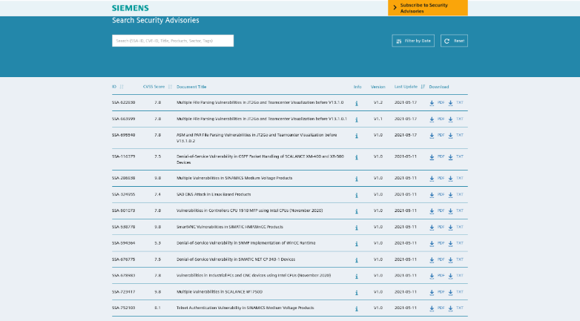

Slide 27
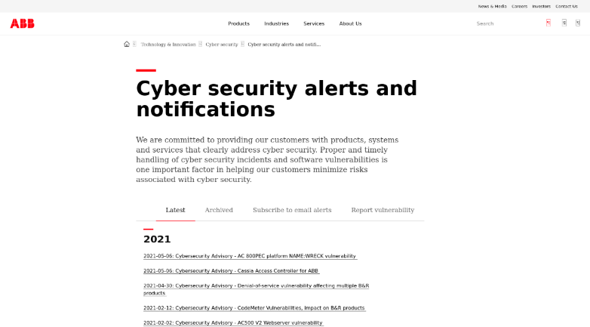

Slide 28
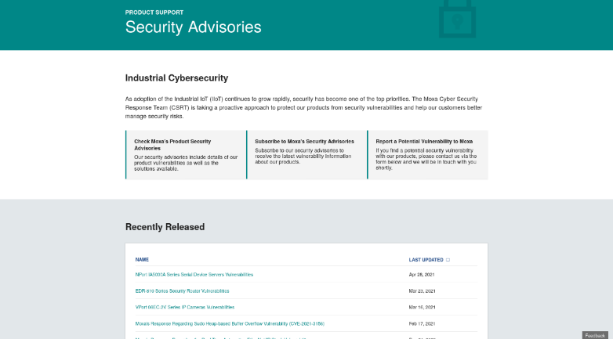

Slide 29
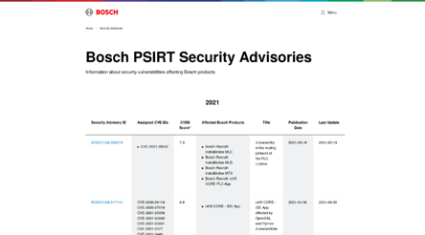
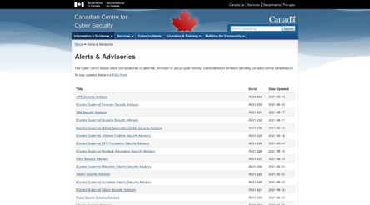

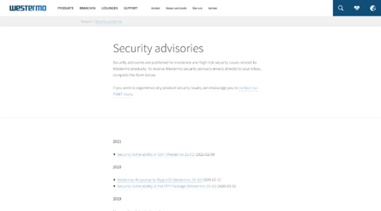
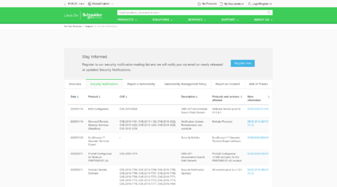
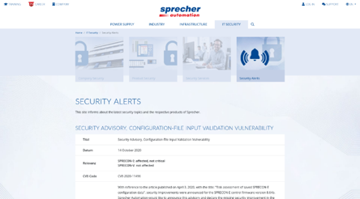
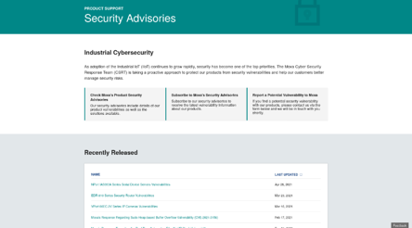
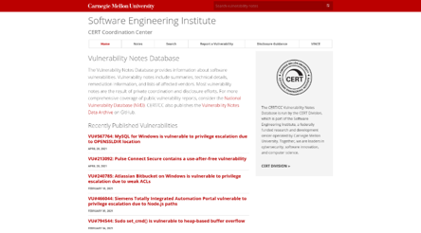
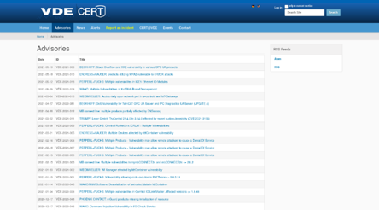
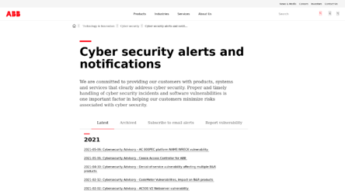
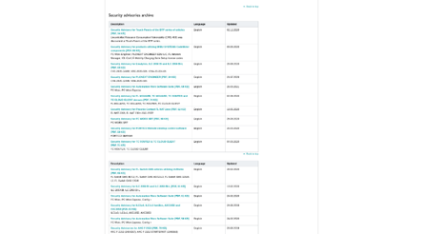
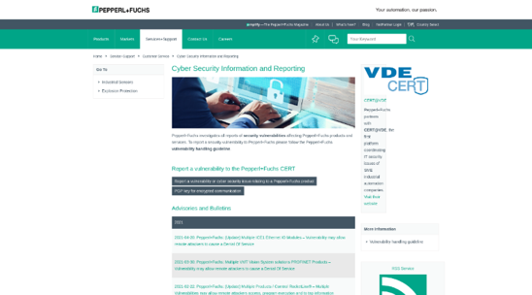
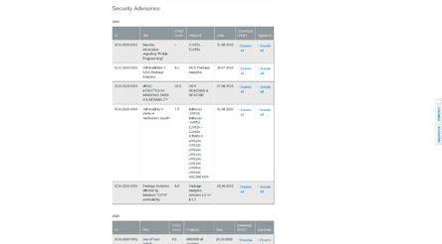
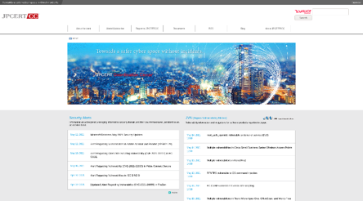
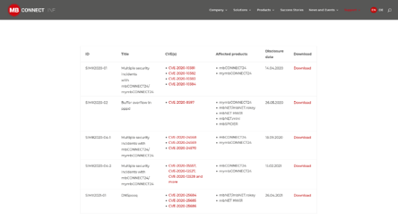
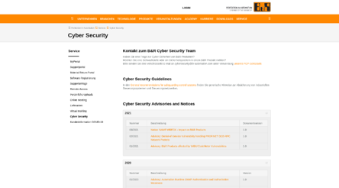
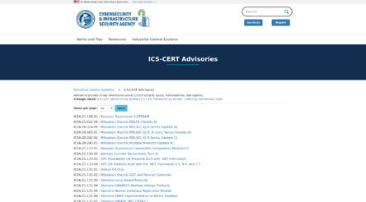

Slide 30
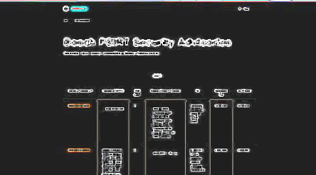
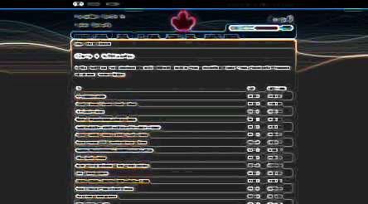
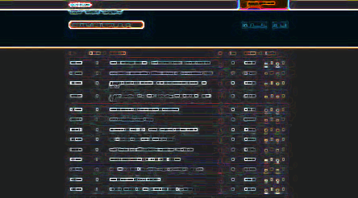
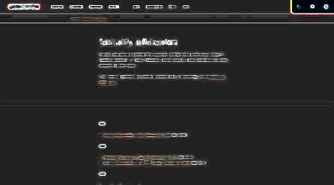
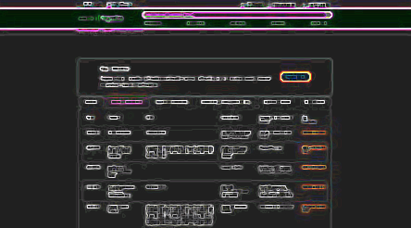
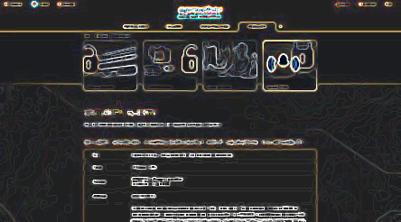
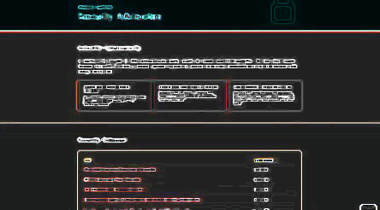
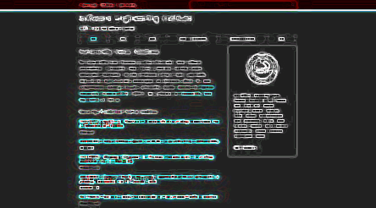
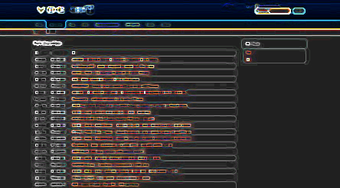
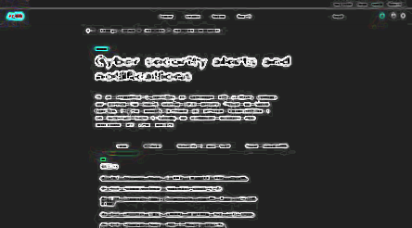
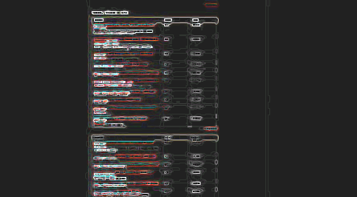
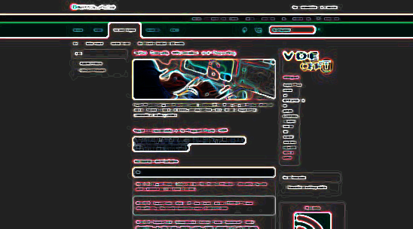
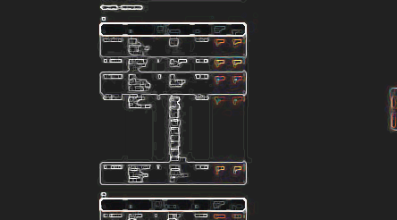
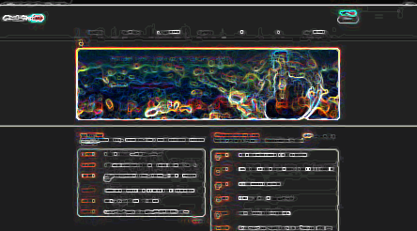
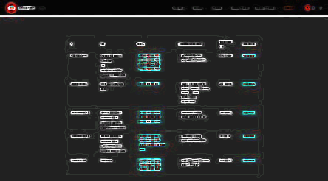
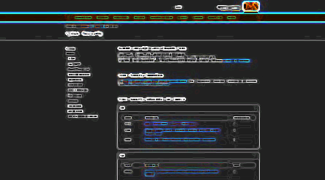
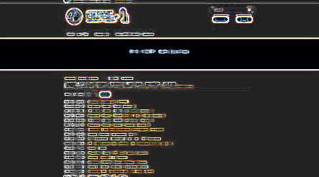
“Negative” security advisories
Notes:
Can use “artistic effects” to invert the colors

Slide 31
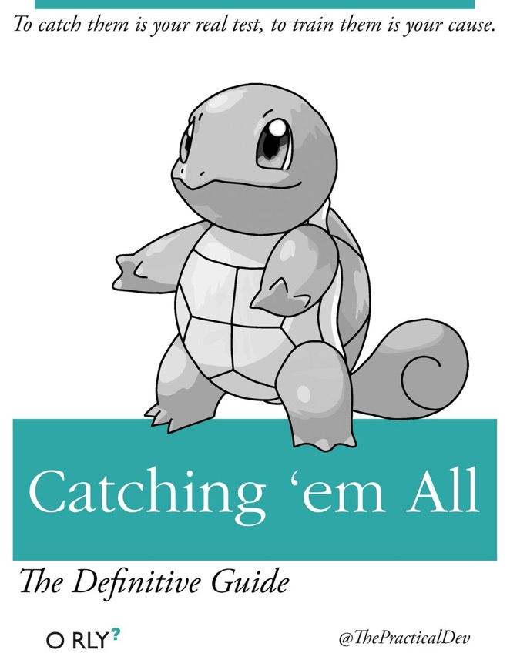
Security Advisories
https://boyter.org/static/books/CnDD1t0XgAQMXJA.jpg
Notes:
Jens
Problem of overload is even more extreme for advisories
We are tasked by law with reading them

Slide 32
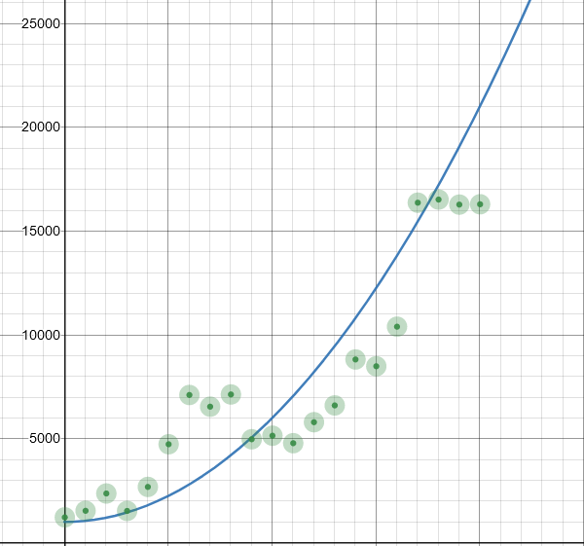
Number of Advisories CVEs
https://opensourcesecurity.io/2021/03/30/its-time-to-fix-cve/

Slide 33
Automation?
Notes:
Where is the automation?

Slide 34
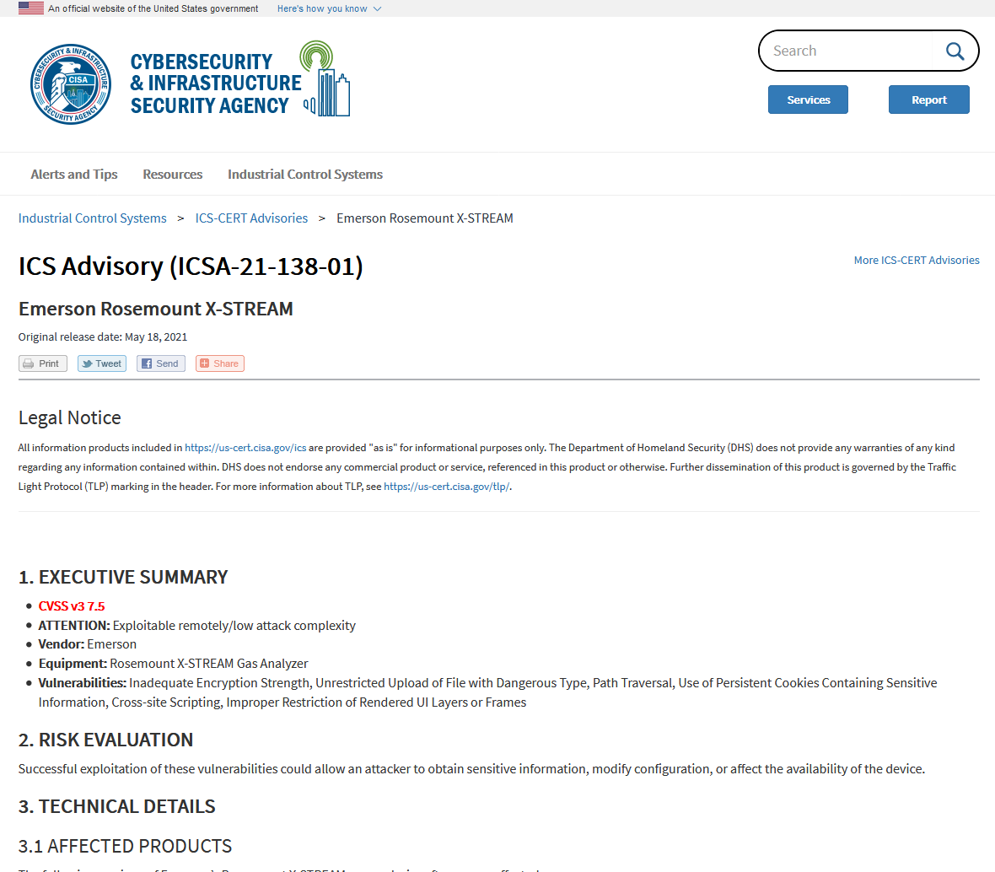
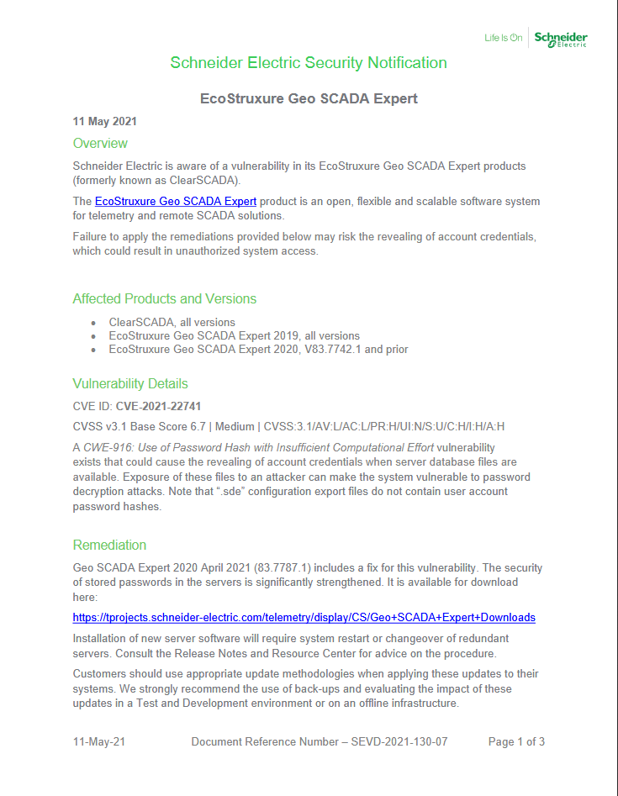
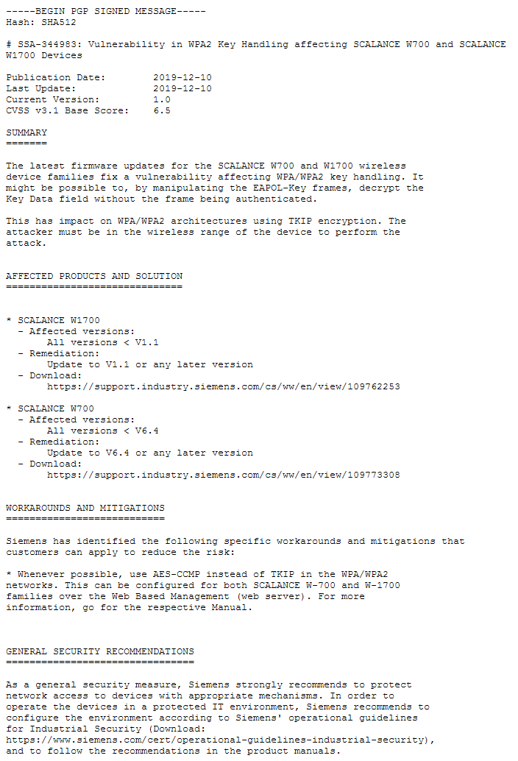

Slide 35




Slide 36
Machine-readable?

Slide 37
Machine-readable?
Human-readable!

Slide 38

Common Security Advisory Framework
CSAF 2.0
JSON format
Machine-readable
Build with automation in mind
Standardization through CSAF TC at OASIS Open
Successor of CSAF CVRF 1.2

Slide 39

Vision of CSAF: Automate security advisories
Automate search for vulnerability information
Automate evaluation and prioritization

Slide 40

So what does this mean for VEX?
VEX becomes a profile in CSAF
Uses same infrastructure and systems
VEX is parallel to SBOM (not necessarily in the SBOM)
Notes:
Photo by mohamed abdelghaffar: https://www.pexels.com/photo/man-in-black-jacket-771742/

Slide 41
Good security teams do the work to determine whether or not affected.
They are already do this – so help them by make this information public. And reward them…
Notes:
Some assumptions – you have a product security team, and that they have some process for analyzing vulnerability data

Slide 42

Straight from the source*
(*source may vary)
Notes:
VEX data can come from the vendor, or from a third party
Bug bounty

Slide 43
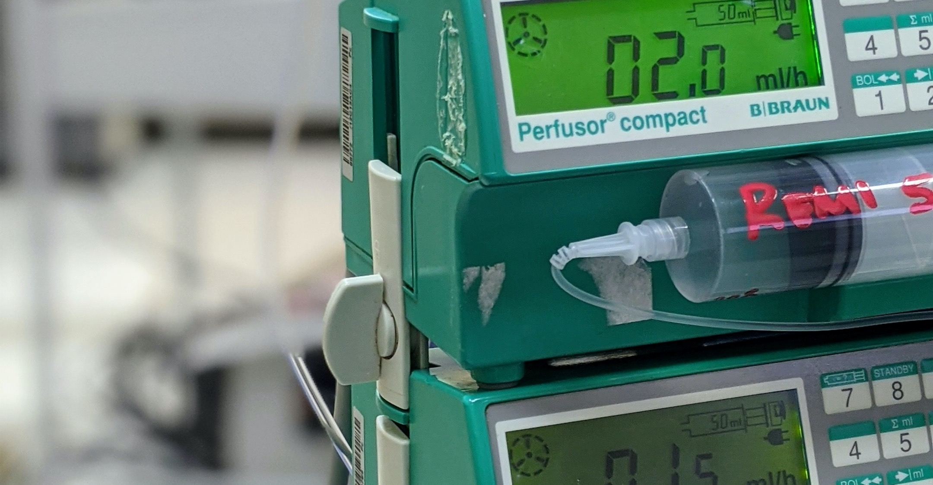
Starting to implement this today
Photo by Matías Ramos on Unsplash

Slide 44

Demand for Attestations
Notes:
Photo by Mikael Blomkvist: https://www.pexels.com/photo/woman-wearing-helmet-and-safety-vest-8960933/

Slide 45

Executive Order 14028 (May 12, 2021) “Improving the Nation’s Cybersecurity”
"The trust we place in our digital infrastructure should be proportional to how trustworthy and transparent that infrastructure is...”
The EO defines SBOM and identifies the value proposition in 10(j)
Section 4: Enhancing Software Supply Chain Security.
4(f) – NTIA defines the “minimum elements” of SBOM
4(e)(vii) –USG defines guidance on “providing a purchaser a Software Bill of Materials (SBOM) for each product”

Slide 46

Executive Order 14028 (May 12, 2021) “Improving the Nation’s Cybersecurity”
"The trust we place in our digital infrastructure should be proportional to how trustworthy and transparent that infrastructure is...”
The EO defines SBOM and identifies the value proposition in 10(j)
Section 4: Enhancing Software Supply Chain Security.
4(f) – NTIA defines the “minimum elements” of SBOM
4(e)(vii) –USG defines guidance on “providing a purchaser a Software Bill of Materials (SBOM) for each product”

Slide 47
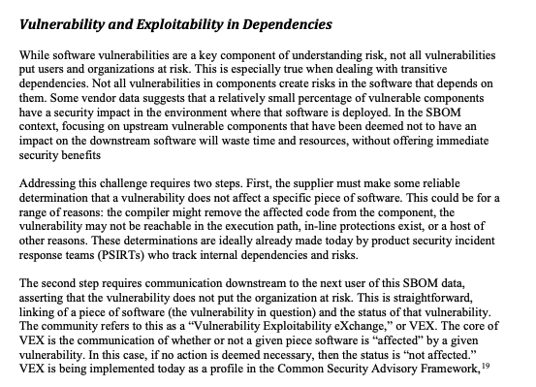
Executive Order 14028 (May 12, 2021) “Improving the Nation’s Cybersecurity”
"The trust we place in our digital infrastructure should be proportional to how trustworthy and transparent that infrastructure is...”
The EO defines SBOM and identifies the value proposition in 10(j)
Section 4: Enhancing Software Supply Chain Security.
4(f) – NTIA defines the “minimum elements” of SBOM
4(e)(vii) –USG defines guidance on “providing a purchaser a Software Bill of Materials (SBOM) for each product”

Slide 48

Show and Tell
Notes:
Photo by Anastasia Shuraeva from Pexels

Slide 49
{ "document": { "category": "VEX_EXAMPLE", "csaf_version": "2.0", "publisher": { "category": "user", "name": "ACME-Energy-Sector", "namespace": "https://fakeacmeurl.com", "contact_details": "Joe Vexmaker, joe.vexmaker@acme.com" }, "title": "ACME-WIDGET-1.0-VEX-DRAFT", "tracking": { "current_release_date": "2021-10-20T16:00:00.000Z", "id": "ACME-2021-12345", "initial_release_date": "2021-10-19T16:00:00.000Z", "revision_history": [ { "date": "2021-10-20T16:00:00.000Z", "number": "1.0.0", "summary": "Initial version. Unofficial content for example/demonstration use only." } ], "status": "final", "version": "1.0.0", "generator": { "date": "2021-10-20T14:19:22.851Z", "engine": { "version": "1.8.0", "name": "Secvisogram" } } }, "notes": [ { "category": "other", "text": "Draft ACME Widget PoC VEX document. Unofficial content and for example/demonstration use only.", "title": "Author Comment" } ] }, "vulnerabilities": [ { "cve": "CVE-2017-0144", "scores": [ { "products": [ "CSAFPID-0002" ], "cvss_v3": { "version": "3.1", "vectorString": "CVSS:3.1/AV:N/AC:H/PR:N/UI:N/S:U/C:H/I:H/A:H/RL:U", "baseScore": 8.1, "baseSeverity": "HIGH", "attackVector": "NETWORK", "attackComplexity": "HIGH", "privilegesRequired": "NONE", "userInteraction": "NONE", "scope": "UNCHANGED", "confidentialityImpact": "HIGH", "integrityImpact": "HIGH", "availabilityImpact": "HIGH", "remediationLevel": "UNAVAILABLE" } } ], "threats": [ { "category": "impact", "details": "The SMB service is turned off by default. The device restricts access to the OS to field service personnel.\nThe device is segmented from the network through the use of an instrument firewall.\nThe device only allows the installation/execution of known/trusted components.", "product_ids": [ "CSAFPID-0001" ] } ], "remediations": [ { "category": "none_available", "details": "A future update will contain a patch that fixes the vulnerability in Windows 7 SP1", "product_ids": [ "CSAFPID-0001" ] } ], "product_status": { "known_affected": [ "CSAFPID-0002" ], "known_not_affected": [ "CSAFPID-0001" ] } } ], "product_tree": { "branches": [ { "category": "vendor", "name": "ACME", "branches": [ { "category": "product_name", "name": "WIDGET", "product": { "product_id": "CSAFPID-0001", "name": "ACME WIDGET 1.0", "product_identification_helper": { "purl": "pkg:supplier/ACME/WIDGET@1.0" } } } ] }, { "category": "vendor", "name": "Microsoft", "branches": [ { "category": "product_family", "name": "Windows", "branches": [ { "category": "product_name", "name": "Embedded Standard 7", "branches": [ { "category": "service_pack", "name": "1", "product": { "product_id": "CSAFPID-0002", "name": "Microsoft Windows Embedded Standard 7 SP1", "product_identification_helper": { "purl": "pkg:supplier/Microsoft/Windows-Embedded-Standard-7-with-SP1-patches@3.0", "cpe": "cpe:2.3:o:microsoft:windows_7:sp1:*:*:*:*:*:*:*" } } } ] } ] } ] } ] }}

Slide 50
{ "document": {
"category": "VEX_EXAMPLE",
"csaf_version": "2.0",
"publisher": {
"category": "user",
"name": "ACME-Energy-Sector",
"namespace": "https://fakeacmeurl.com",
"contact_details": "Joe Vexmaker, joe.vexmaker@acme.com"
},
"title": "ACME-WIDGET-1.0-VEX-DRAFT",
"tracking": {
"current_release_date": "2021-10-20T16:00:00.000Z",
"id": "ACME-2021-12345",
"initial_release_date": "2021-10-19T16:00:00.000Z",
"revision_history": [
{
"date": "2021-10-20T16:00:00.000Z",
"number": "1.0.0",
"summary": "Initial version. Unofficial content for example/demonstration use only."
}
],
"status": "final",
"version": "1.0.0",
"generator": {
"date": "2021-10-20T14:19:22.851Z",
"engine": {
"version": "1.8.0",
"name": "Secvisogram"
}
}
},
"notes": [
{
"category": "other",
"text": "Draft ACME Widget PoC VEX document. Unofficial content and for example/demonstration use only.",
"title": "Author Comment"
}
]
},

Slide 51
"vulnerabilities": [
{
"cve": "CVE-2017-0144",
"scores": [
{
"products": [
"CSAFPID-0002"
],
"cvss_v3": {
"version": "3.1",
"vectorString": "CVSS:3.1/AV:N/AC:H/PR:N/UI:N/S:U/C:H/I:H/A:H/RL:U",
"baseScore": 8.1,
"baseSeverity": "HIGH",
"attackVector": "NETWORK",
"attackComplexity": "HIGH",
"privilegesRequired": "NONE",
"userInteraction": "NONE",
"scope": "UNCHANGED",
"confidentialityImpact": "HIGH",
"integrityImpact": "HIGH",
"availabilityImpact": "HIGH",
"remediationLevel": "UNAVAILABLE"
}
}
],
"threats": [
{
"category": "impact",
"details": "The SMB service is turned off by default. The device restricts access to the OS to field service personnel.\nThe device is segmented from the network through the use of an instrument firewall.\nThe device only allows the installation/execution of known/trusted components.",
"product_ids": [
"CSAFPID-0001"
]
} ],
"remediations": [
{
"category": "none_available",
"details": "A future update will contain a patch that fixes the vulnerability in Windows 7 SP1", "product_ids": [ "CSAFPID-0001"
]
}
],

Slide 52
"product_status": {
"known_not_affected": [
"CSAFPID-0001"
]
}
}
],

Slide 53
"product_tree": {
"branches": [
{
"category": "vendor",
"name": "ACME",
"branches": [
{
"category": "product_name",
"name": "WIDGET",
"product": {
"product_id": "CSAFPID-0001",
"name": "ACME WIDGET 1.0",
"product_identification_helper": {
"purl": "pkg:supplier/ACME/WIDGET@1.0"
}
}
}
]
},
{
"category": "vendor",
"name": "Microsoft",
"branches": [
{
"category": "product_family",
"name": "Windows",
"branches": [
{
"category": "product_name",
"name": "Embedded Standard 7",
"branches": [
{
"category": "service_pack",
"name": "1",
"product": {
"product_id": "CSAFPID-0002",
"name": "Microsoft Windows Embedded Standard 7 SP1",
"product_identification_helper": {
"purl": "pkg:supplier/Microsoft/Windows-Embedded-Standard-7-with-SP1-patches@3.0", "cpe": "cpe:2.3:o:microsoft:windows_7:sp1:*:*:*:*:*:*:*“
}
} }
}
}

Slide 54
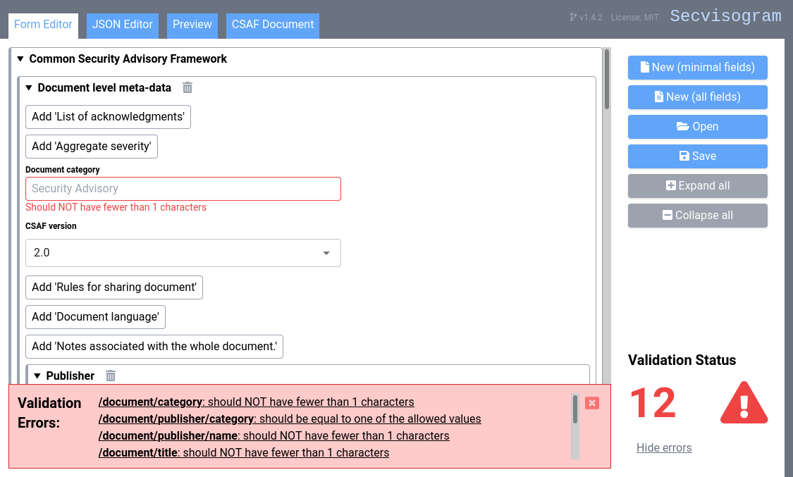
Secvisogram - secvisogram.github.io
Notes:
Jens

Slide 55


Slide 56


Slide 57


Slide 58


Slide 59

Work continues

Slide 60
“Modality” of VEX – Use Cases
Product
Product
Product
Product
Product
vuln
vuln
vuln
vuln
vuln
status
status
status
status
status

Slide 61

“Flags” → Status Justifications
Component_not_present
Vulnerable_code_of_component_not_ present
Vulnerable_code_cannot_be_controlled_by_adversary
Vulnerable_code_not_in_execute_path
Inline_mitigations_already_exist

Slide 62
Alright! Problem solved!
Notes:
Allan

Slide 63
Alright! Problem solved?
No. We still need your support to make it work.
Notes:
Allan

Slide 64

Automation Opportunities & Challenges
Distribution & retrieval of VEX
Push vs Pull
Centralization
Integration of VEX with existing tools
Trust judgements vs. policies
Linking VEX data
SBOMs ✔️
SBOM components ✔️
Software identitifiers 😬
Notes:
Photo by Andrea De Santis on Unsplash

Slide 65

Come build things!
Standardization is boring.
We need tools!
Need experienced product teams to make sure this fits their models
Plenty of room for startups to take advantage and show leadership
Notes:
Allan: Startups and open source projects

Slide 66
Number of vulnerabilities discovered is rising
Better insights in supply chain
}
More advisories
Advisories are needed for risk-based decisions
Manual processes don’t scale
Automation is possible – so automate the boring stuff
Publish also “known not affected” to reduce questions at support hotline
Come help! (or offer constructive criticism)
VEX and other resources: cisa.gov/SBOM
CSAF information: github.com/oasis-tcs/csaf
allan.friedman@cisa.dhs.gov
@allanfriedman
Notes:
We look forward to having you join the conversation!

